Slide 1
http://www.vidyanidhi.com/
ketkiacharya.net@gmail.com
Ketki Acharya
From: SM VITA ATC of CDAC
ketkiacharya.net@gmail.com

Slide 2
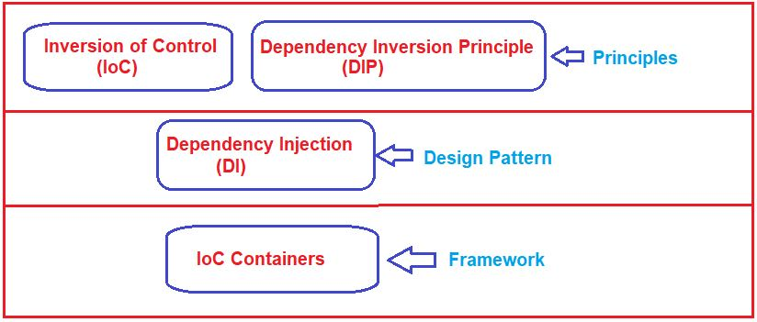
Design Pattern:
The Design patterns are reusable solutions to the problems that we encounter in our day-to-day programming. They are basically used to solve the problems of object generation and integration. For example, if you want to create a class that can have only one instance for the entire application then you can use the Singleton design pattern which ensures that a class has only one instance for the entire application and provides a global point of access to it. There are so many design patterns that are tested by others and are safe to follow. For example. Gang of Four Design Patterns: Abstract Factory, Factory, Singleton, etc.
As principles, they only provide some high-level guidelines or mechanisms to develop software applications but they do not provide any specific implementation details. Dependency Injection is a design pattern whereas IoC Containers are frameworks.

Slide 3
Inversion of Control (IoC) in C#:
The main objective of Inversion of Control (IoC) in C# is to remove the dependencies (remove tight coupling) between the objects of an application which makes the application more decoupled and maintainable.
The IoC Design Principle suggests the inversion of various types of controls in object-oriented design to achieve loose coupling between the application classes. Here, control means any extra responsibilities a class has other than its main or fundamental responsibility. For example, control over the flow of an application, control over the dependent object creation, etc.
Let’s say you have a “repository” class, and that the repository class is responsible for giving data to you from a data source. The repository class could establish a connection to the data source by itself without anyone else’s input. But, consider the situation, what if it is allowed you to pass the connection details about the data source through the repository class constructor?
By allowing the caller to provide the connection details through a class constructor, we have actually decoupled the data source connection dependency from the repository class, allowing any data source to work with the repository, not the one which the repository specifies. Here, we have inverted the control by handing the responsibility of creating the connection details about the data source from the repository class to the caller class.
Martin Fowler recommends using the term “Dependency Injection” to describe this type of Inversion of Control since Inversion of Control is a principle, it can be utilized more comprehensively than simply injecting dependencies in a constructor method.

Slide 4
Understanding the Dependency Inversion Principle in C#:
The Dependency Inversion Principle in C# also helps us to achieve loose coupling between the classes. It is highly recommended to use both DIP and IoC together in order to achieve loose coupling between the classes. The DIP (DIP) states that high-level modules/classes should not depend upon low-level modules/classes. Both should depend upon abstractions. Secondly, abstractions should not depend upon details. Details should depend upon abstractions.
We need to keep the High-level module and Low-level module as loosely coupled as possible. When a class knows about the design and implementation of another class, it raises the risk that if we do any changes to one class will break the other class. So we must keep these high-level and low-level modules/classes loosely coupled as much as possible. To do that, we need to make both of them dependent on abstractions instead of knowing each other.
DIP is invented by Robert Martin (a.k.a. Uncle Bob). He is a founder of SOLID principles.

Slide 5
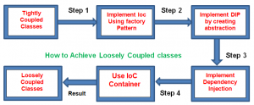
IoC Containers in C#:
The IoC Container is a great framework to create dependencies and inject them automatically whenever required throughout the application so that we as software programmers don’t have to put additional time and effort into it. It automatically creates the necessary objects based on the request and also automatically injects them whenever required. DI Container helps us to manage dependencies within the application in a straightforward and simple way.
There are different IoC Containers available for .NET such as Unity, Ninject, StructureMap, Autofac, etc.
We can’t accomplish loosely coupled classes by just utilizing IoC in C#. Along with IoC we additionally need to utilize DIP, DI, and IoC containers to achieve loosely coupled. The following diagram illustrates how we are going to achieve loosely coupled design

